Slide 1
IT531 Advance Computer Networks Week 5_Lec 3
OSPF protocol-II

Slide 2
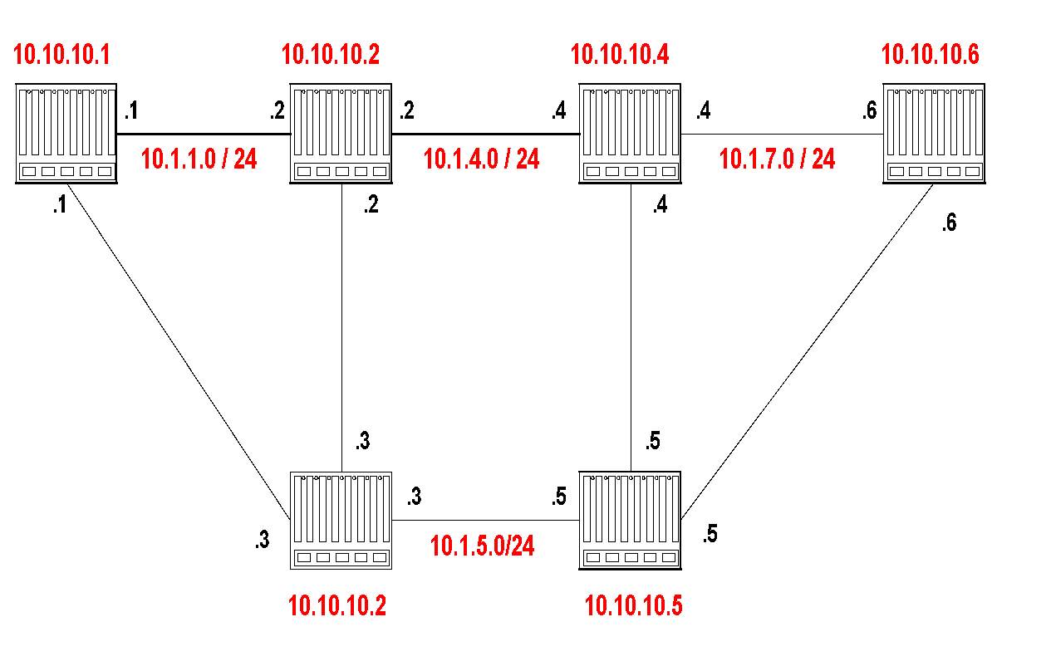
Example Network
Router IDs are selected independent of interface addresses
Link costs are called Metric
Metric is in the range [0 , 2¹⁶]
Metric can be asymmetric

Slide 3
Link state Advertisements
The LSA of router 10.10.10.1 is as follows:
Link State ID: 10.10.10.1 = can be Router ID
Advertising Router: 10.10.10.1 = Router ID
Number of links: 3 = 2 links plus router itself
Description of Link 1: Link ID = 10.1.1.1, Metric = 4
Description of Link 2: Link ID = 10.1.2.1, Metric = 3
Description of Link 3: Link ID = 10.10.10.1, Metric = 0

Slide 4
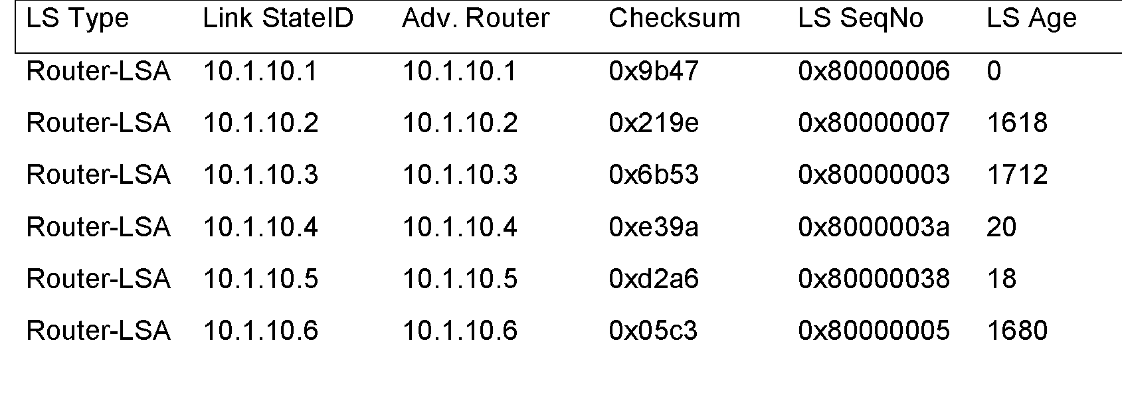
Link State Database
The collection of all LSAs is called the link-state database
Each router has an identical link-state database
Useful for debugging: Each router has a complete description of the network
If neighboring routers discover each other for the first time, they will exchange their link-state databases
The link-state databases are synchronized using reliable flooding

Slide 5
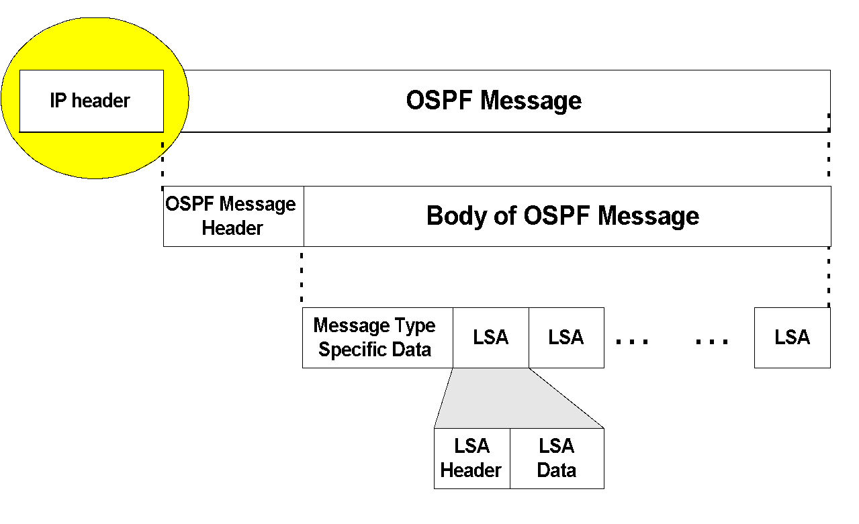
OSPF Packet format
OSPF packets are not carried as UDP payload!
OSPF has its own IP protocol number: 89
TTL: set to 1 (in most cases)
Destination IP: neighbor’s IP address or 224.0.0.5 (ALLSPFRouters) or 224.0.0.6 (AllDRouters)

Slide 6
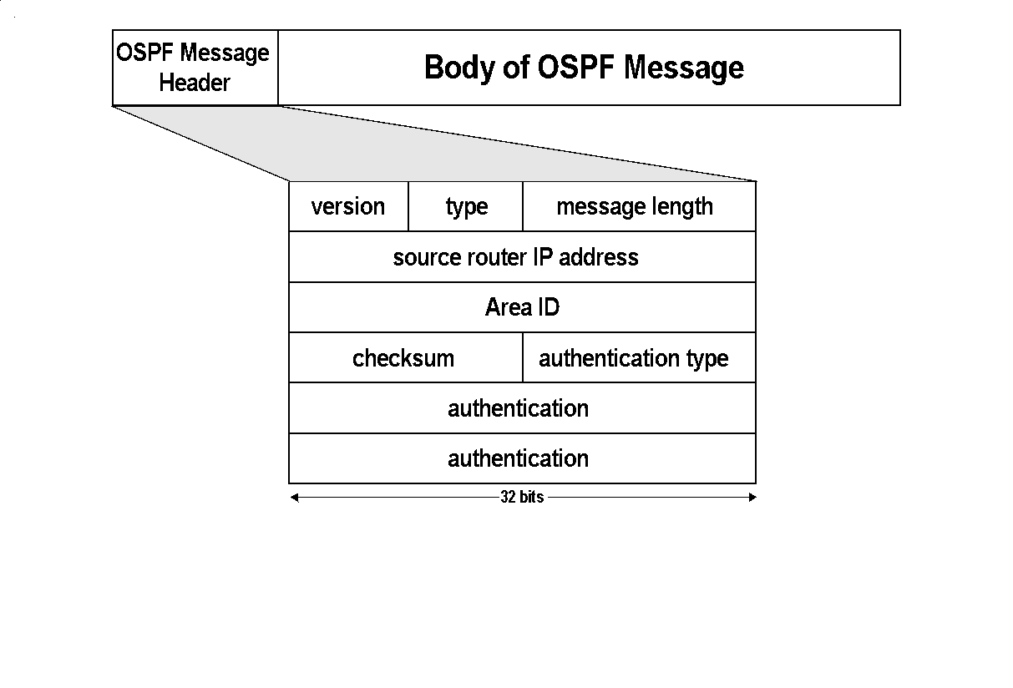
Message types:
1: Hello (tests reachability)
2: Database description
3: Link Status request
4: Link state update
5: Link state acknowledgement

Slide 7
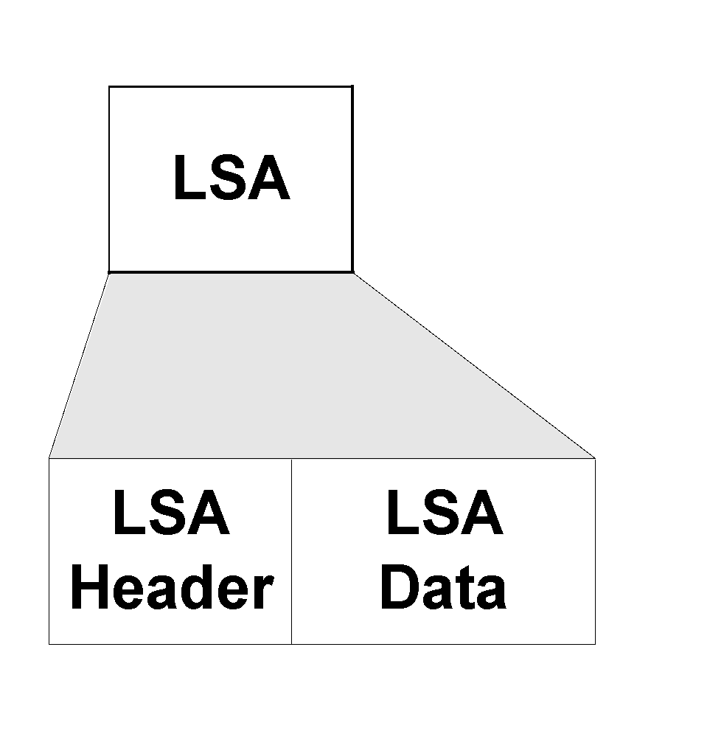
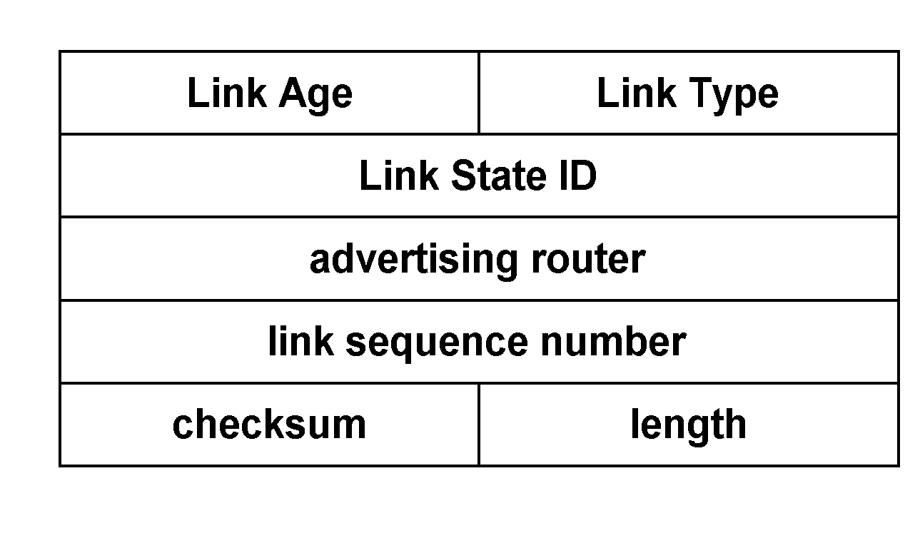
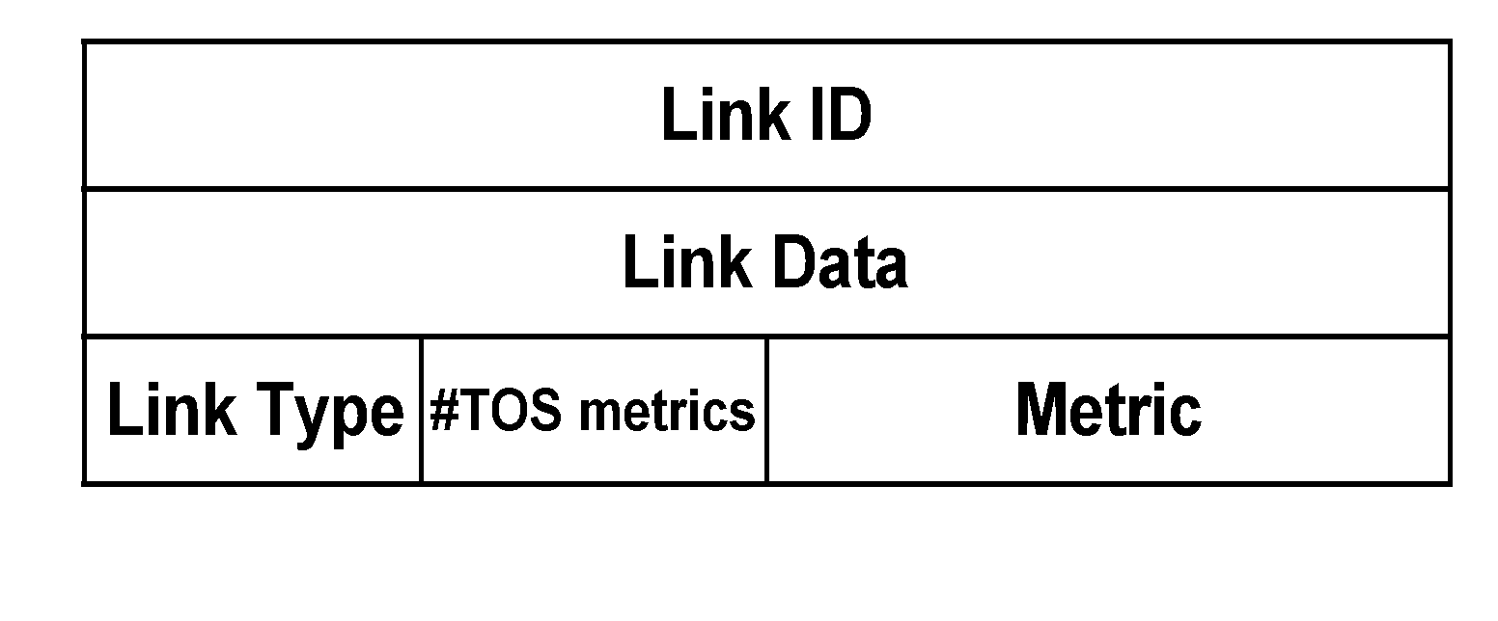
OSPF LSA format
LSA Header
Link 1
Link 2
LSA Header
Link 1
Link 2

Slide 8
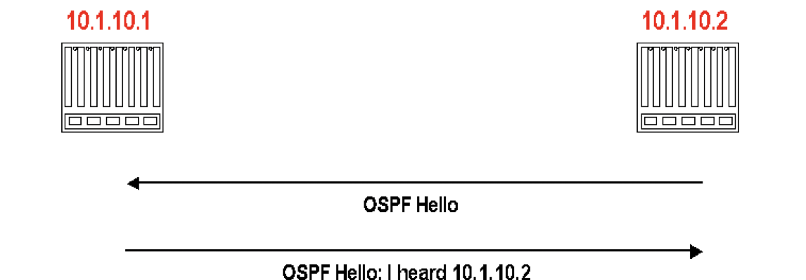
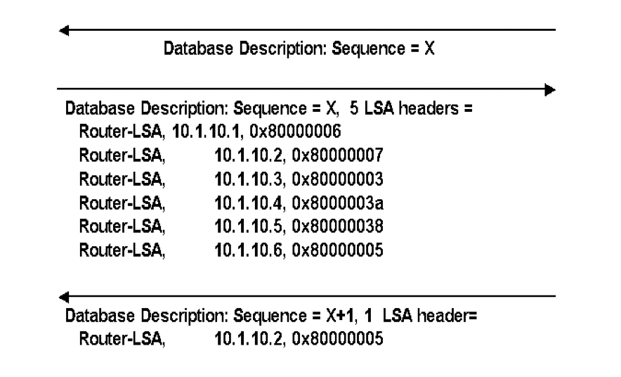

Discovery of adjacency
After neighbors are discovered the nodes exchange their databases
Sends database description. (description only contains LSA headers)
Database description of 10.1.10.2
Acknowledges receipt of description
Routers multicasts OSPF Hello packets on all OSPF-enabled interfaces.
If two routers share a link, they can become neighbors, and establish an adjacency
After becoming a neighbor, routers exchange their link state databases

Slide 9
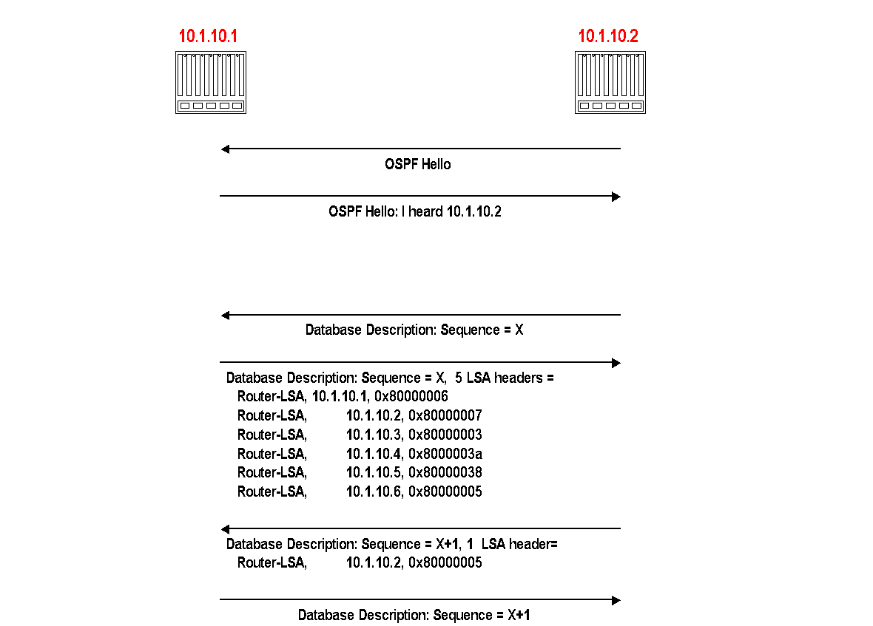

Slide 10
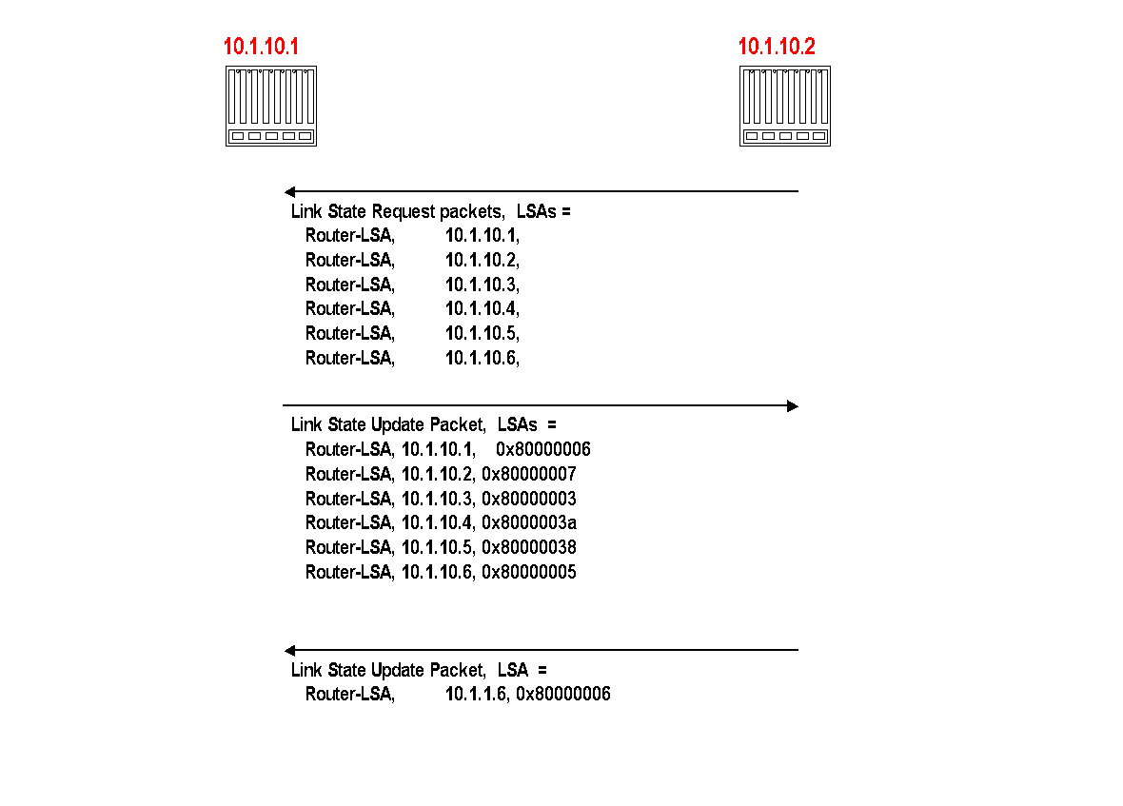
Regular LSA Exchanges
A router sends and refloods LSA-Updates, whenever the topology or link cost changes. (If a received LSA does not contain new information, the router will not flood the packet)
Exception: Infrequently (every 30 minutes), a router will flood LSAs even if there are no new changes.
Acknowledgements of LSA-updates:
explicit ACK, or
implicit via reception of an LSA-Update
10.1.10.2 explicitly requests each LSA from 10.1.10.1
10.1.10.2 has more recent value for 10.0.1.6 and sends it to 10.1.10.1 (with higher sequence number)

Slide 11
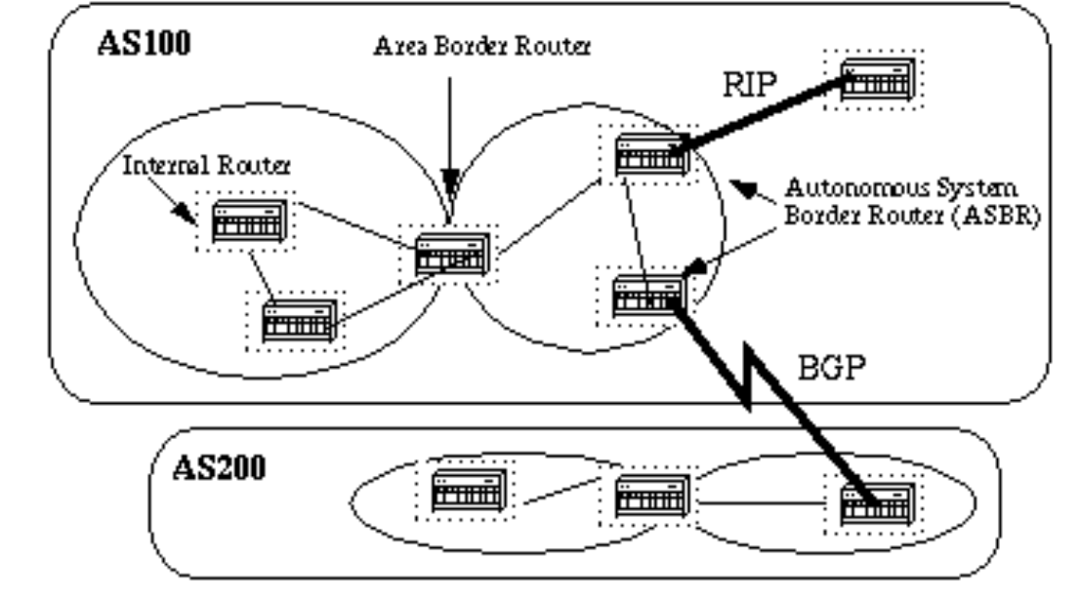
Autonomous System
An autonomous system is a region of the Internet that is administered by a single entity.
Examples of autonomous regions are:
DAIICT organization
Any Internet Service Provider’s network
Routing is done differently within an autonomous system (intradomain routing) and between autonomous system (interdomain routing – Border Gateway Protocol ).

Slide 12
Hierarchical OSPF
two-level hierarchy: local area, backbone.
link-state advertisements flooded only in area, or backbone
each node has detailed area topology; only knows direction to reach other destinations
area border routers: “summarize” distances to destinations in own area, advertise in backbone
boundary router: connects to other ASes
backbone
backbone router: runs OSPF limited to backbone
local routers:
flood LS in area only
compute routing within area
forward packets to outside via area border router
area 3
internal
routers
area 1
area 2

